Slide 1

Financial Analysis
Presented By Yogesh S.

Slide 2
Table of contents
KPI Summary
Revenue & Cost Trend Over Time
Profit Trend Analysis
Cost Distribution by Type
Total Transaction Amount by Transaction Type
Revenue by Transaction Type
Attrition Rate by Card Category
Customers by Age Group
Credit Limit vs Avg Utilization
Attrition Rate by Relationship Count
ANALYST RECOMMENDATIONS

Slide 3
KPI Summary
Total Revenue: ₹2.1M indicating overall business scale.
Total Cost: ₹264.6K, relatively controlled against revenue.
Profit: ₹1.83M showing strong profitability.
Total Customers: ~12K active customers.
Attrition Rate: 17.44%, a key risk area to monitor.

Slide 4
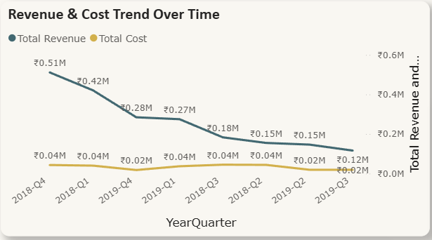
Revenue & Cost Trend Over Time
Revenue shows a consistent downward trend from 2018-Q4 to 2019-Q3.
Costs remain relatively stable across quarters.
Gap between revenue and cost is narrowing → margin pressure.
Indicates possible demand decline or reduced transaction volume.

Slide 5
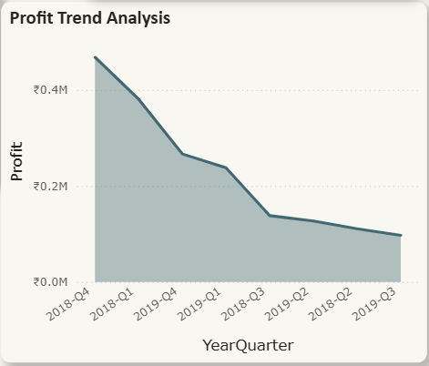
Profit Trend Analysis
Profit has steadily declined over time.
Highest profit observed in early periods, followed by continuous drop.
Decline aligns with falling revenue rather than rising costs.
Signals need for revenue revitalization strategies.

Slide 6
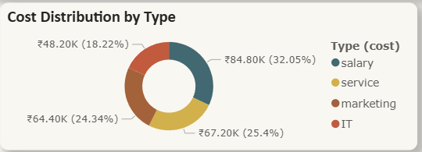
Cost Distribution by Type
Salary (32%) is the largest cost component.
Service (25%) and Marketing (24%) form a major share.
IT costs (18%) are comparatively lower.
Cost structure is people and service heavy.

Slide 7
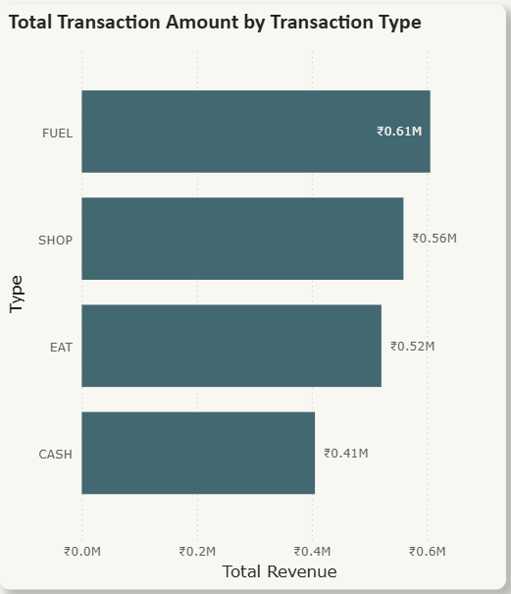
Total Transaction Amount by Transaction Type
Customers prefer merchant-based transactions (Fuel, Shop, Eat) over cash withdrawals.
Fuel and Shop categories are critical revenue drivers, likely due to frequent and recurring usage.
Lower contribution from cash suggests a shift toward digital payments, which are typically more profitable.

Slide 8
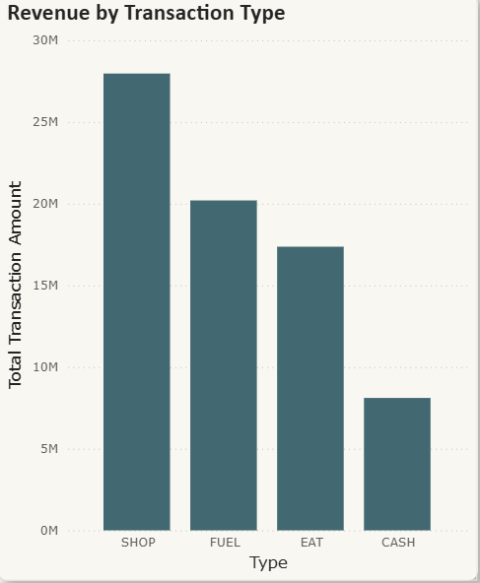
Revenue by Transaction Type
SHOP contributes the highest revenue.
FUEL and EAT are strong secondary contributors.
CASH transactions generate the lowest revenue.
Digital/merchant-based transactions outperform cash usage.

Slide 9
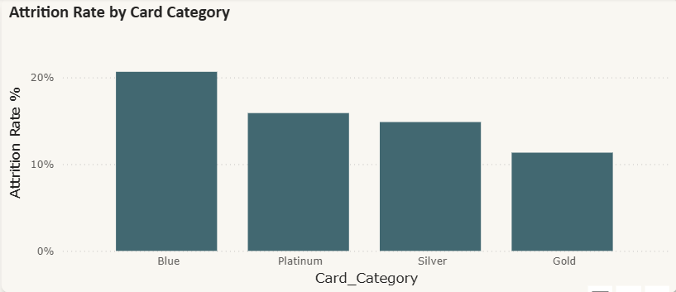
Attrition Rate by Card Category
Entry-level customers (Blue) are more price-sensitive and less loyal.
Premium customers (Gold) likely receive better benefits and engagement, reducing churn.
Card category is a strong predictor of customer retention.

Slide 10
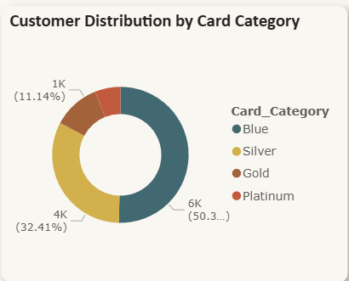
Customers by Age Group
Blue card holders (>50%) dominate the customer base.
Silver (>32%) is the second largest segment.
Gold & Platinum together form a smaller premium segment.
High dependency on entry-level customers.

Slide 11
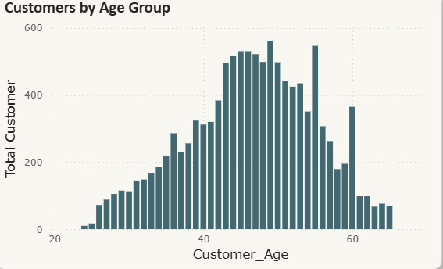
Credit Limit vs Avg Utilization
Majority of customers fall in the 40–55 age range.
Fewer younger (<30) and older (>60) customers.
Indicates a mid-age, financially stable customer base.

Slide 12
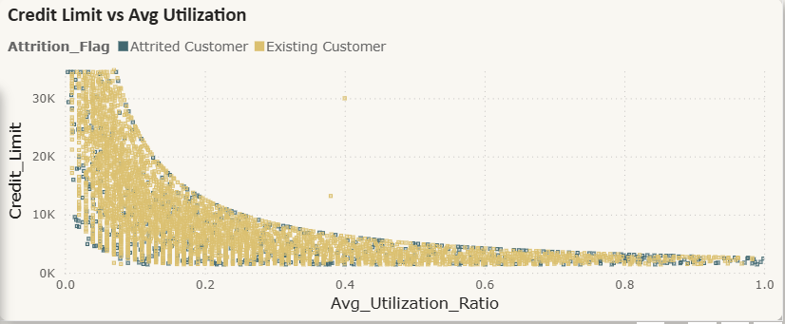
Credit Limit vs Avg Utilization
Clear inverse relationship between credit limit and utilization.
High utilization mostly seen in low credit limit customers.
Attrited customers are more concentrated at high utilization levels.
High utilization may signal financial stress → attrition risk.

Slide 13
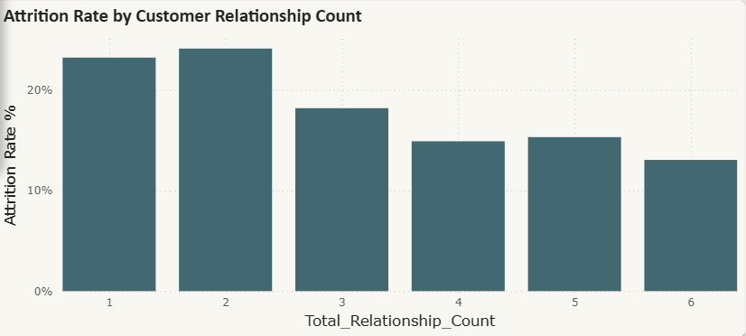
Attrition Rate by Relationship Count
Highest attrition seen with 1–2 relationship counts.
Attrition decreases as relationship count increases.
Customers with 5–6 relationships are more loyal.
Engagement depth strongly impacts retention.

Slide 14
ANALYST RECOMMENDATIONS
Reduce Attrition
Target customers with 1–2 relationships using cross-sell offers.
Introduce loyalty benefits for early-stage customers.
Monitor high-utilization customers for proactive retention.
Improve Revenue Trend
Boost SHOP and FUEL transaction campaigns.
Introduce merchant partnerships and cashback programs.
Promote digital payments over cash transactions.
Optimize Cost Structure
Review salary and service costs for efficiency improvements.
Increase ROI tracking on marketing spend.
Automate processes to reduce operational overhead.
Grow High-Value Segment
Upsell Blue → Silver/Gold customers with tailored offers.
Develop premium benefits to grow Platinum customer base.
Focus on customers aged 40–55 with long-term financial products.
Credit Risk Management
Set alerts for high utilization ratios.
Offer structured repayment plans or credit limit reviews.
Use utilization patterns as an early warning signal for churn.

